Slide 1
3 Axis Pin Development Update
Week #8

Slide 2
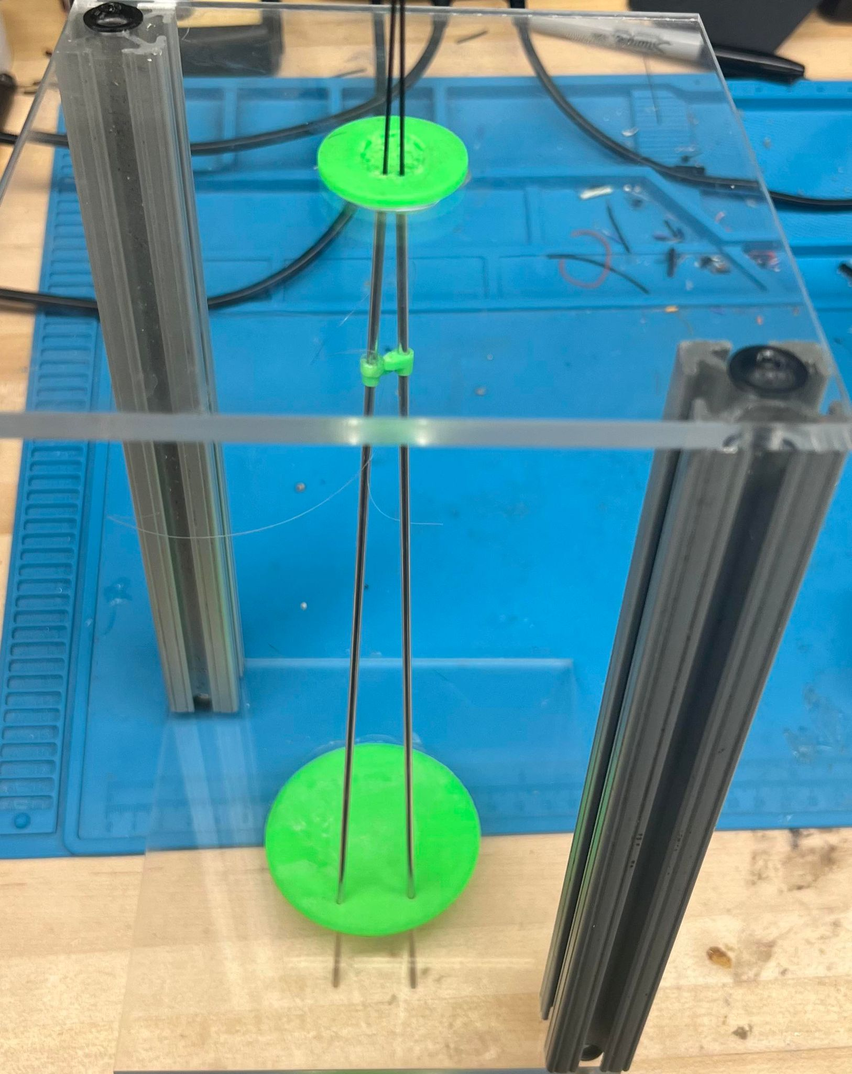
Previously On…
Pivot Point

Slide 3
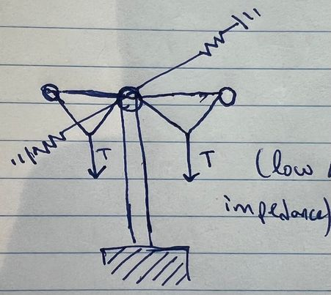
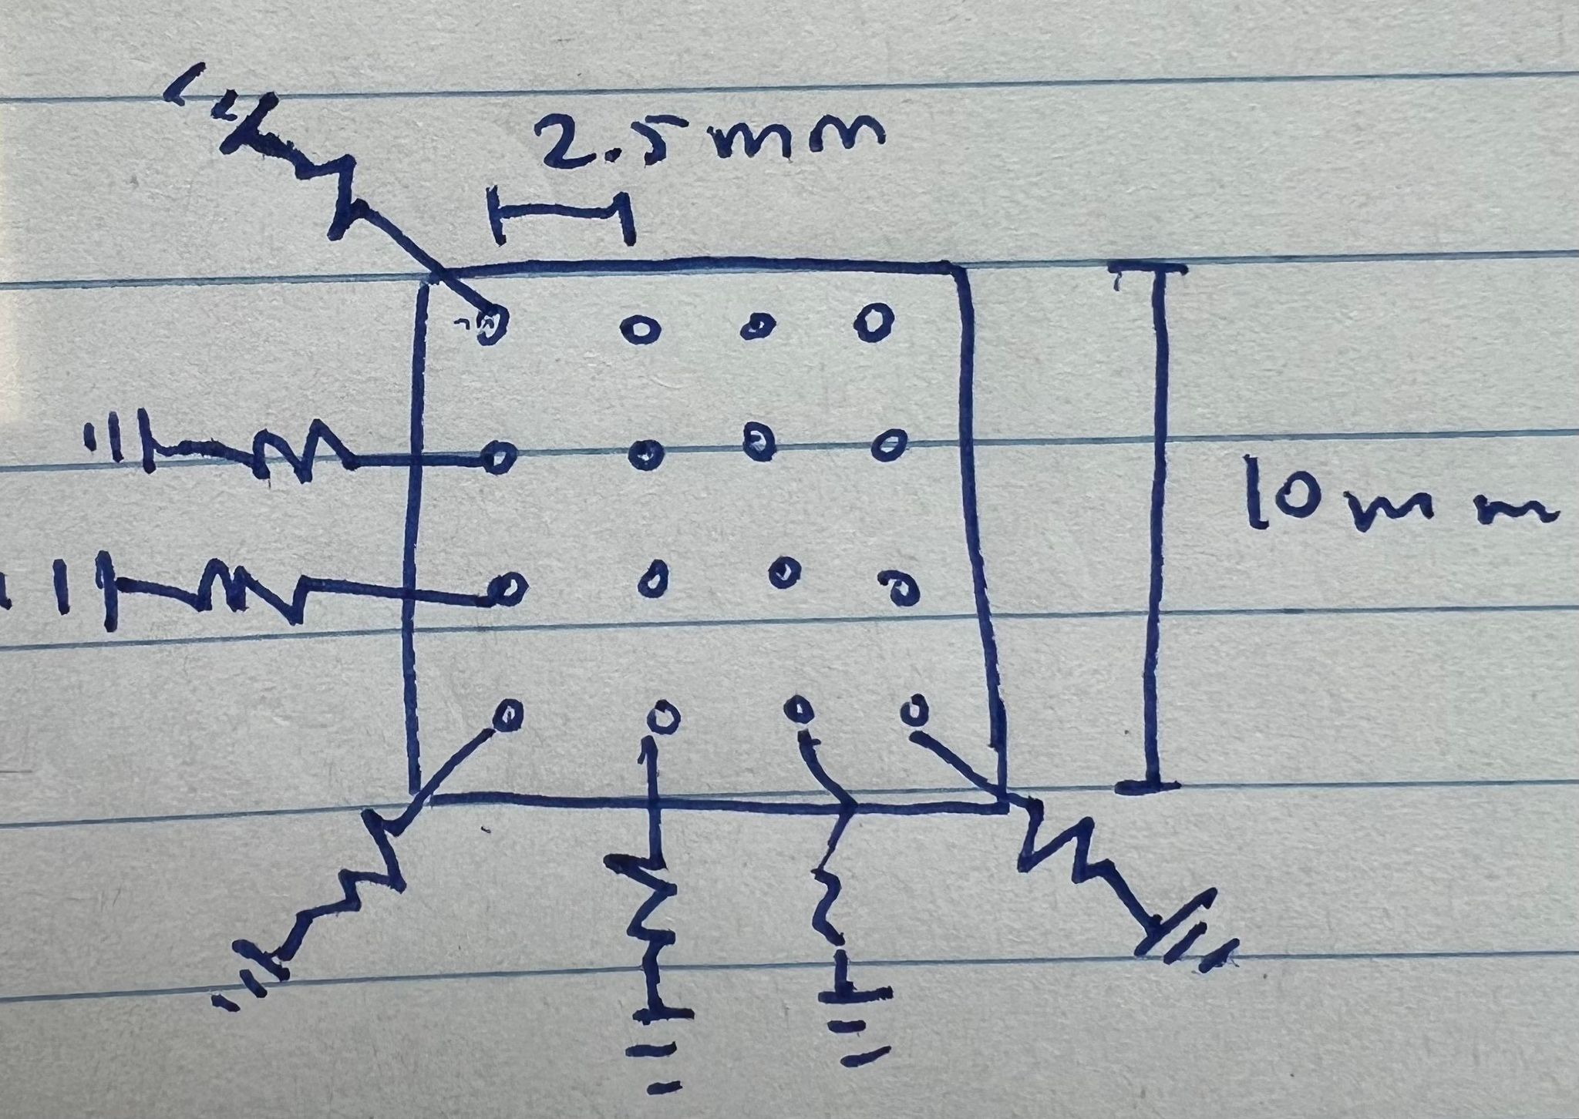
Still Previously On…

Slide 4
Idea
F
F

Slide 5

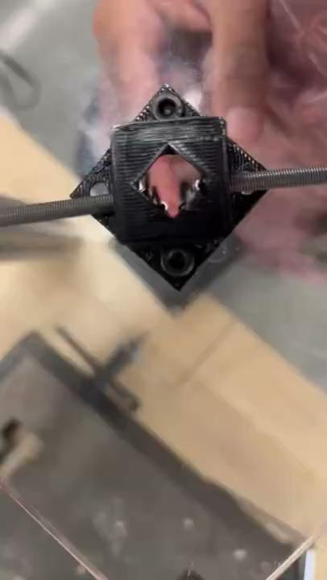
Iteration #2

